Slide 1
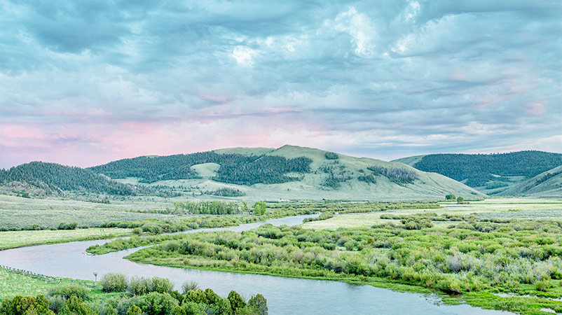
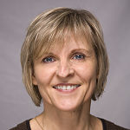
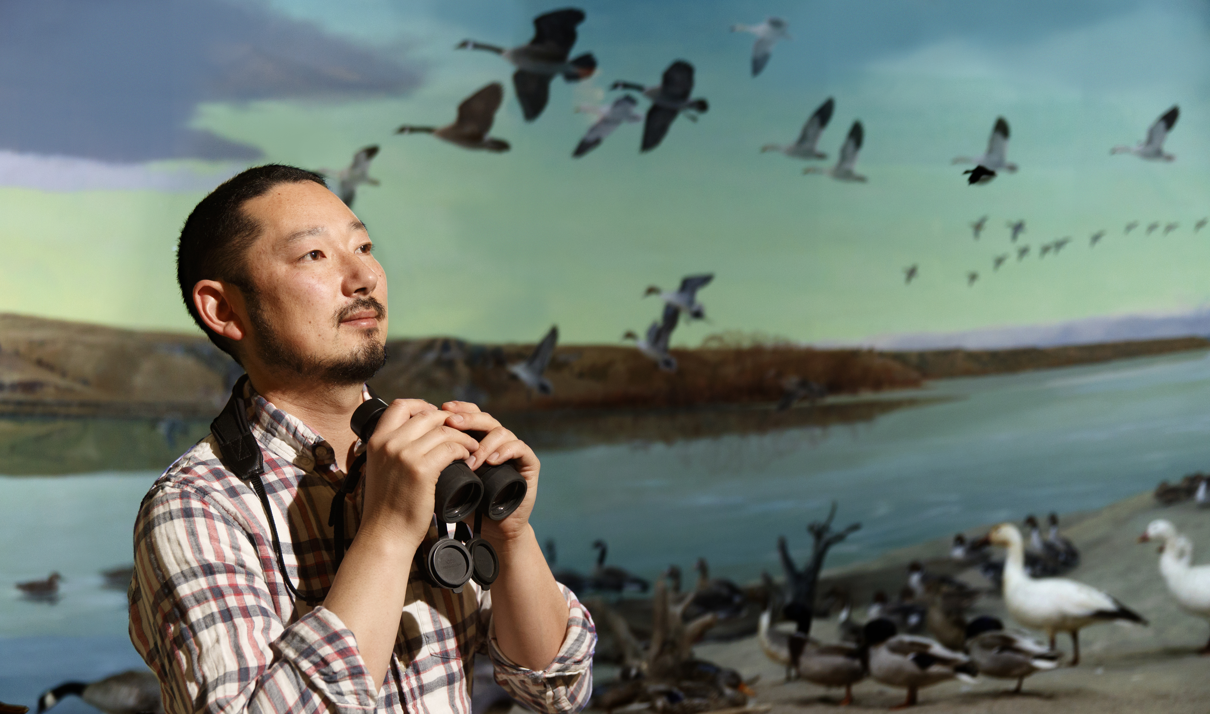

That’s fishy… unraveling Platte River fish resilience in response to drought events.
Jack Rodenburg
Advisor: Dr. Brigitte Tenhumberg Collaborators: Dr. Mark Pegg (SNR)
Dr. Dai Shizuka, Dr. Kate Lyons

Slide 2
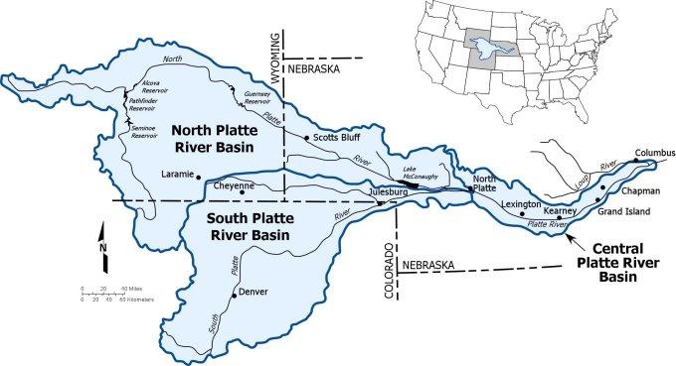
Introduction
Freshwater ecosystems are biodiversity hotspots
Increasing human activity (recreational, industrial) puts these ecosystems at risk.

Slide 3
Introduction
Freshwater ecosystems are biodiversity hotspots
Increasing human activity (recreational, industrial) puts these ecosystems at risk.

Slide 4
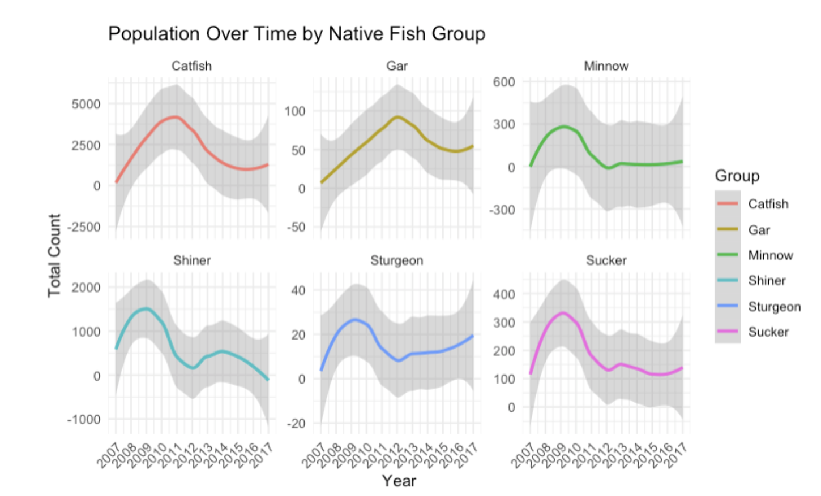

Slide 6
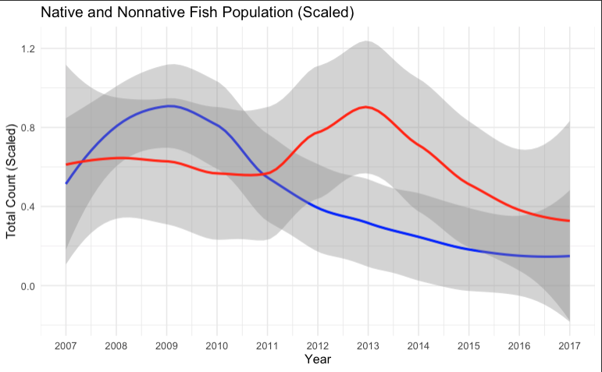

Slide 7
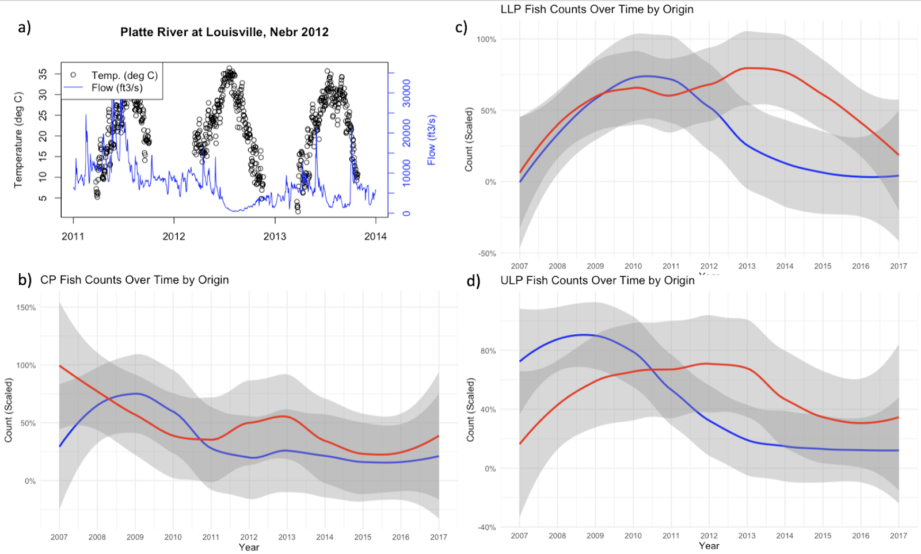
Nebraska Department of Natural Resources “Drought of 2012 Storymap” (2021)

Slide 9
